Slide 1
C2P India
QA Track - Tools

Slide 2

TABLE OF CONTENTS
1
Overview
2
NotePad++
3
SQL Developer
4
Winscp
5
Putty

Slide 3
Overview
This section gives an overview of various small software’s which tester is expected to have on his machine
Software | Usage
Notepad ++ (with XML tools plug-in if possible) | Manipulating and editing test files
SQL Developer | Database queries
Win SCP | For accessing servers (copying log files ,etc)
PuTTY | For viewing system logs (especially in tail mode)

Slide 4
Notepad++
Notepad+ + is a text editor and source code editor for Windows. Its advantage it allows is tabbed editing, to easily work with multiple open files. Distributed as free software and is excellent for manipulating XML files.
Features:
Displays XML files in a nice readable manner.
Tabbed document interface
Drag-and-drop
Multiple Clipboard (plugin required)
Split screen editing and synchronized scrolling
Spell checker
Supports text encoding formats such as Unicode, for international writing systems
Find and replace over multiple documents
File comparison
Zooming

Slide 5
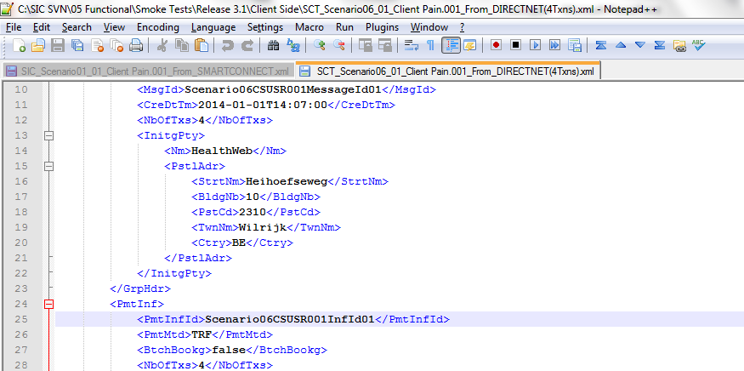
Notepad++ Snapshot

Slide 6
SQL Developer
Oracle SQL Developer is an IDE for working with SQL in Oracle databases. Oracle Corporation provides this product free; it uses the Java Development Kit. We use it to extract information from the database.
How to use SQL Developer:
Connect to the correct database:
Each time you connect to a NEW database, the following information is required to make the connection:
Connection Name – enter a name here for which you will ready recognise the connection the next time you want to use it.
Username – for all internal test servers = bphadmin.
Password = password.
Hostname = IP address of server (or alias / domain name)
Port = 1521
SID = bph

Slide 7
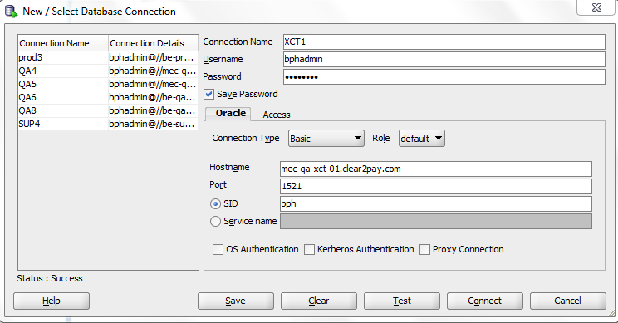
SQL Developer - Connecting to DB

Slide 8
WinSCP
WinSCP (Windows Secure CoPy) is a free and open source SFTP and FTP client for Microsoft Windows. Its main function is secure file transfer between a local and a remote computer. Beyond this, WinSCP offers basic file manager and file synchronisation functionality.
Features:
User is allowed to copy data from local machine to server via just drag and drop
Also the data from server to local machine cab be copied directly.
View the data in Winscp directly.
Open the data in local editor. When the doc is saved remote version is updated automatically.
Connecting to Server:
Each time you connect to a NEW server, the following information is required to make the connection:
Host Name = IP address of server (or alias / domain name)
Port # = 22
Username (for all internal test servers) = wasadmin
Password = password

Slide 9
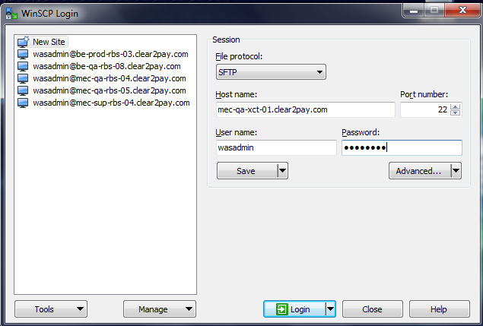
WinSCP - Connecting to server

Slide 10
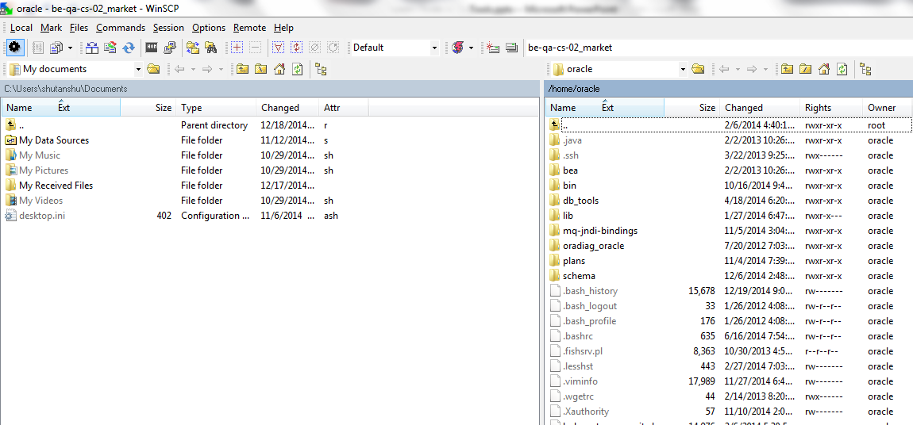
WinSCP - Snapshot

Slide 11
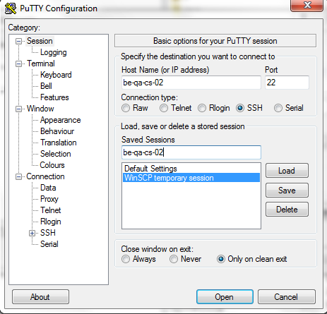
PuTTY
Putty is a tool used for Viewing/searching and scrolling though logs during QA execution.
Viewing Logs Using Putty
1.Connect to the server as wasadmin (see above)
a.In some server you have the possibility to enter the comment ./viewlog which is a shortcut to the log and will automatically open it in tail mode)
2.Go to the location of logs by typing ‘cdlogs’ and press <enter>
3.The command ‘ls’ (or ‘dir’) will give you a directory list - there should be SystemOut.log.
4.Type <less log file name> and press enter. So type <less SystemOut.log>
5.The following commands will help viewing the logs:-
a.<shift f> = tail mode
b.<ctrl C> = quit tail mode
c.shift g = takes you to the end of the log file
d.<line number + shift g> directs you to line number specified (e.g. 1 shift g = start)
e.you can scroll the logs using the arrows, and page up and down.
f.‘q’ to quit
g./ word enables a search of the log (‘n’ for next ; ‘b’ for back)
6.You can also use the command <tail –f log file name>; this puts you directly into ‘tail’ mode. So this would be tail -f SystemOut.log <enter>
7.Clicking on the top left ‘computer icon’ displays the options menu – for copying, opening other sessions etc.
8.As an additional help, once you have executed step (g), from the $ prompt, type ./viewlogs - this command will put you directly into tail mode.

Slide 12
Questions?

